Slide 1

LOCATION FOR INDIAN RESTAURANT IN PHILADELPHIA
Abhishek AIYANGAR

Slide 2
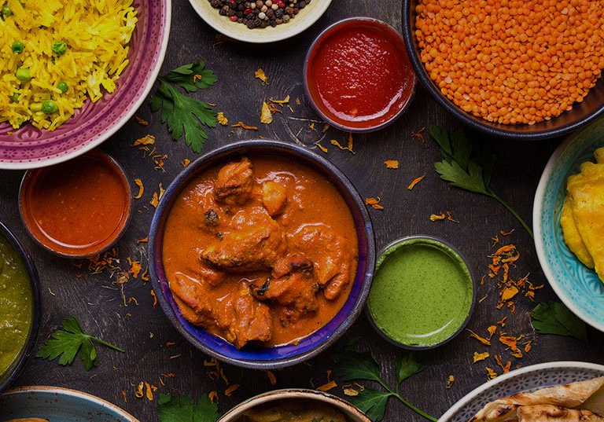
INTRODUCTION
Problem Statement: Determine the best neighborhood in the city of Philadelphia to setup an Indian restaurant.
Background: Currently, Philadelphia has a few Indian restaurants scattered across various neighborhoods of the city. Following are some of the problems associated with Indian restaurants in the city:
Quality of food: lack of authentic Indian cuisine
Price ($$$): unaffordable to students
Distance: located away from public transportation
Ambience: very messy to extremely lavish
Audience: The idea described above will resonate with entrepreneurs and businesses who intend to serve quality authentic Indian food to the entire community of Philadelphia, focused specifically on the student population of the city.

Slide 3
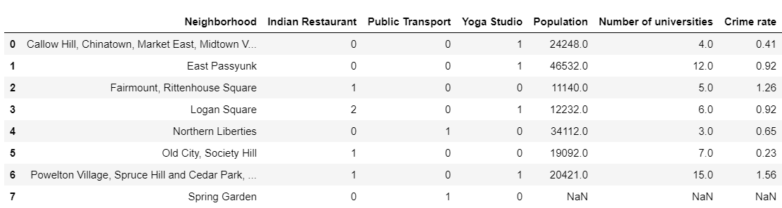
Data
The following were the data elements used as features variables for the analysis:
Number of Indian restaurants in the neighborhood
Number of Public Transport options
Number of culturally relevant vendors (i.e. Yoga studios)
Population density
Number of universities
Crime rate

Slide 4
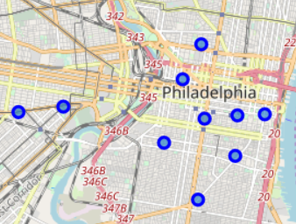
ANLAYSIS
The following analysis was performed to better understand the neighborhoods in Philadelphia:
Map of Philadelphia with neighborhoods superimposed

Slide 5
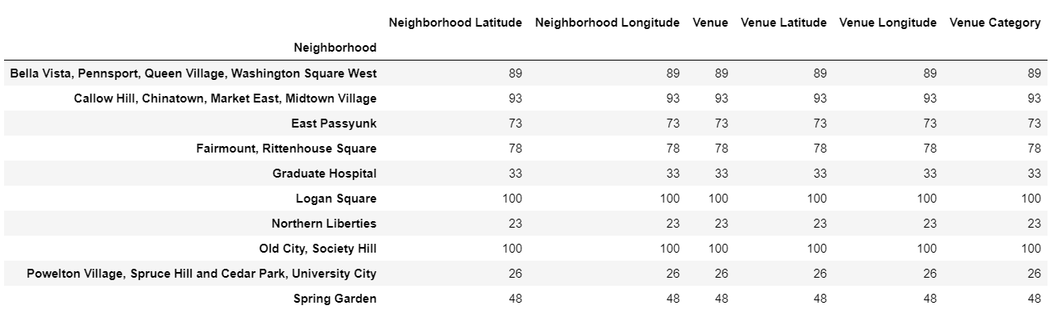
ANLAYSIS
Number of Venues and categories by each neighborhood

Slide 6
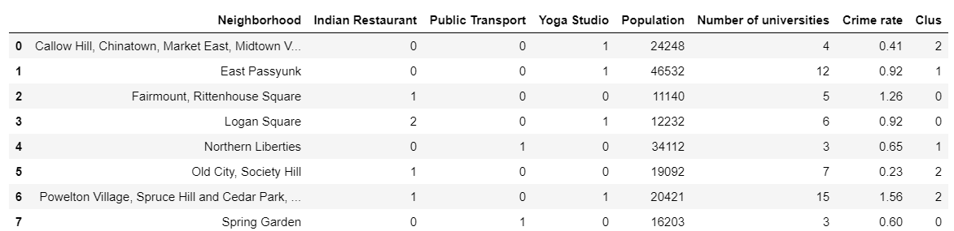
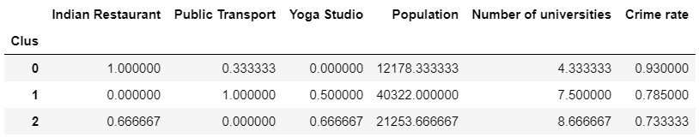
Machine learning
Since we were dealing with an exploratory having no training data, a clustering algorithm (k means) was used for prediction. The rationale behind using clustering was to cluster the neighborhoods based on similarity and then select the cluster containing the criteria closest to our liking.

Slide 7
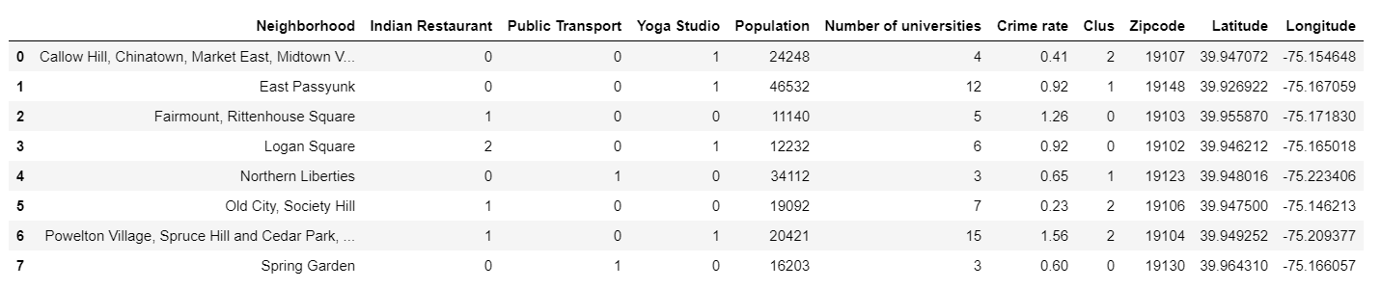
RESULTS
Based on the above data, we can conclude the following about each cluster:
Cluster 0: The least number of universities, highest crime rate and the most number of indian restaurants. This easily makes it the weakest choice for an Indian restaurant.
Cluster 1: Best public transport options, highest population, and a high number of universities. However, the most population in the cluster and also no other Indian restaurants i.e. no competition, makes it the best choice for an Indian restaurant
Cluster 2: No public transport, but the highest number of universities and the least crime rate makes this an alternative option.

Slide 8
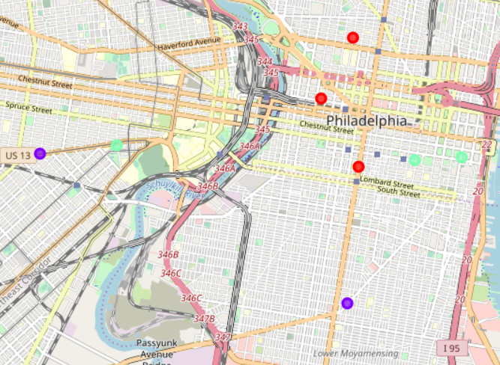
RESULTS

